Slide 1

Move one glass only…
There are 6 glasses on a table , three glasses on the left that are full and three on the right that are empty.
If you make one change you will have a row of alternate full and empty glasses.

Slide 2

objectives
At the end of the lesson, students should be able to:
Sate what is an interrupt
Outline the process of how the processor handles interrupt

Slide 3

What is an Interrupt?
Interrupts are a response by the processor to a process/event that needs immediate attention from the software.
It alerts the processor and servers that a request for the CPU to stop the currently executing program/code, in order so that the event can be processed.
If the response is accepted from the processor, the processor will respond by suspending its current activities (saving its state), and then executing a function called an interrupt handler to deal with the event.

Slide 4
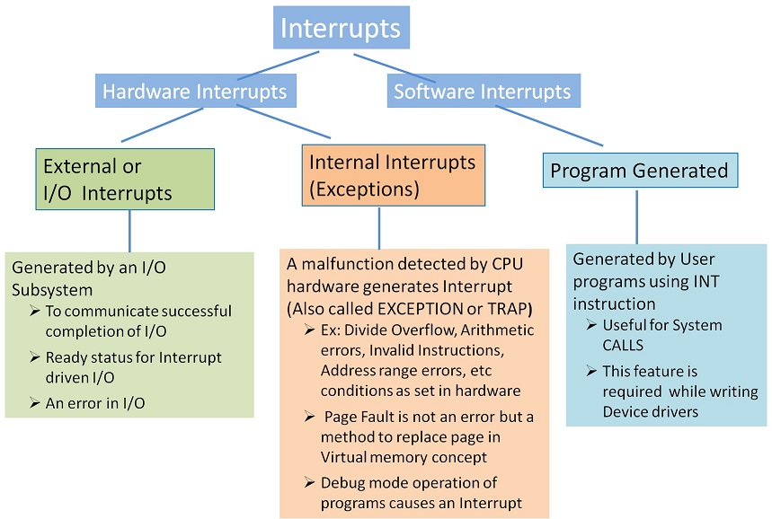
Interrupt- types
Hardware interrupt: is a signal sent by a hardware device or a specific condition in the computer's hardware. Example
When a peripheral device (e.g., a keyboard, mouse, disk drive) needs attention, it can send an interrupt request to the CPU to indicate that data is ready to be transferred.
A system timer generates regular interrupts such as scheduling tasks, keeping track of time, and triggering time-sensitive events.
Detecting an error or a critical condition (e.g., overheating, power failure).

Slide 5
Interrupt- types
Software interrupt also known as a trap or exception, is a mechanism used by a program to request a service from the operating system or to signal an event that needs attention.
Example
When a program needs to perform operations that require higher privileges or access to resources managed by the operating system (such as file I/O, network communication, etc.)
If an error condition occurs during program execution, the program might trigger a software interrupt to handle the error such as like displaying an error message or terminating the program.
A program might generate a software interrupt to indicate a specific event, such as a division by zero or an illegal instruction.

Slide 6
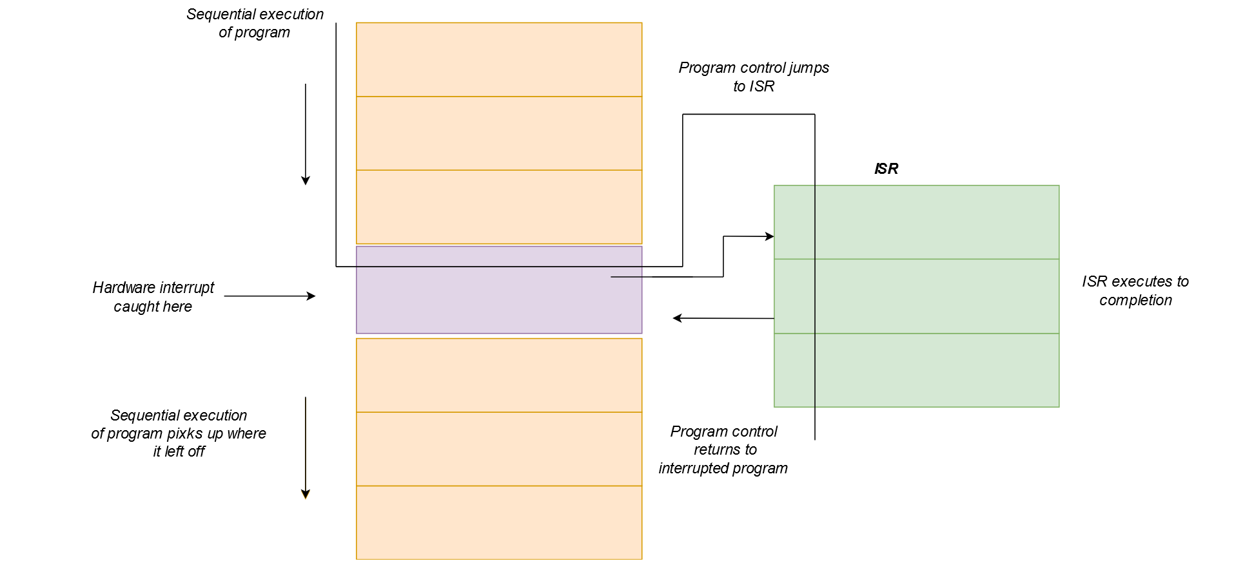
What is an interrupt handler?
Interrupt handlers, also commonly known as Interrupt service routine (ISR), is a block of code that is associated with a specific interrupt condition
Interrupt handlers are responsible for handling interrupts promptly and effectively.
Their primary role is to service interrupts and perform necessary actions associated with specific events.
Interrupt handlers ensure that time-critical tasks, such as responding to user input or processing data from hardware devices, are addressed in a timely manner.

Slide 7
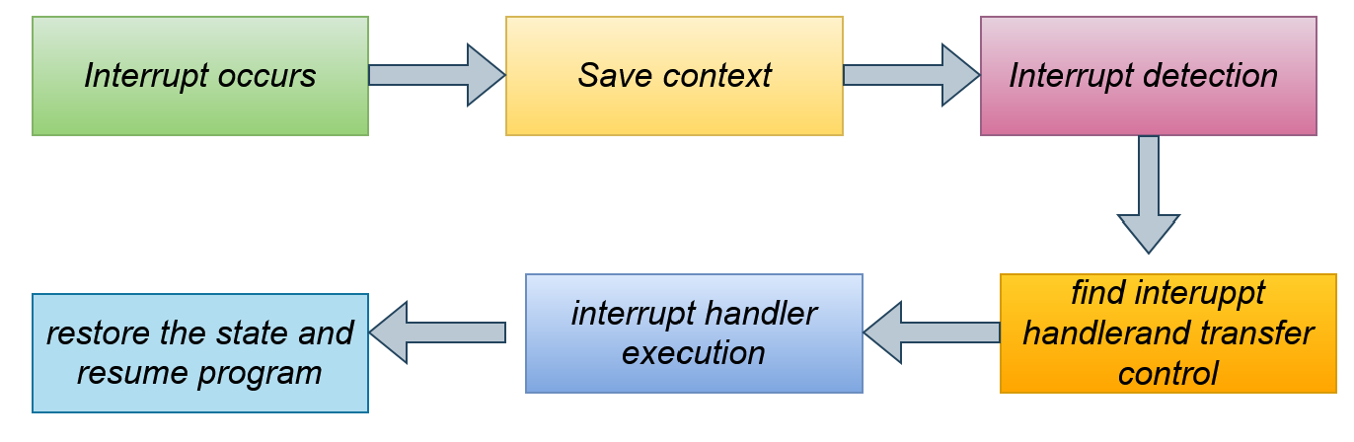
How the processor handle an interrupt
When an interrupt occurs
the processor first saves the current state of the interrupted program, including register values and the program counter.
It then identifies the specific interrupt request (IRQ) associated with the event and acknowledges the interrupt.
The processor uses the interrupt number or IRQ line to locate the corresponding interrupt handler in the interrupt vector table (IVT).
The control is transferred to the interrupt handler's memory address, where the necessary code is executed to handle the interrupt.
The interrupt handler performs actions specific to the interrupt, such as interacting with hardware devices or processing data.

Slide 8
How the processor handle an interrupt
Once the interrupt is handled, the saved state is restored, and the interrupted program resumes execution from where it left off.
This workflow ensures that interrupt events are promptly addressed while preserving the integrity of the interrupted program.
By saving and restoring the program state, interrupt handling ensures that the interrupted program can easily resume execution after the interrupt is serviced.

Slide 9
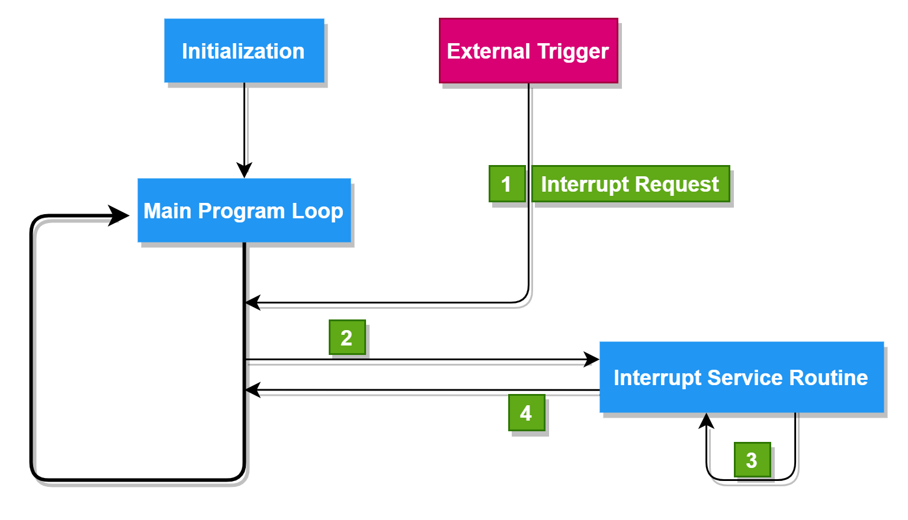
How interrupt are handled by different processor
RISC processors due to their simplified instruction set and architecture, often handle interrupts in a straightforward and efficient manner.
Support multiple interrupt levels or priority levels. This allows the processor to prioritize interrupts based on their urgency or importance.
When an interrupt occurs, the processor checks the priority of the interrupt against the current priority level, and if necessary, switches to a higher-priority task.
It uses a simple interrupt vector table (IVT) to store the addresses of the Interrupt Service Routines (ISRs).
It uses the interrupt number to index the IVT and retrieve the address of the corresponding ISR.
To prevent nested interrupts, RISC processors often disable further interrupts while processing the current one.

Slide 10
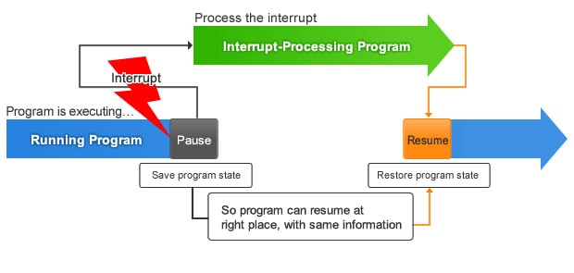
How interrupt are handled by different processor
CISC processors general handle interrupt similar to RISC processor.
CISC may have more complex interrupt handling mechanisms to accommodate the variety of instructions and the potential need for more extensive state saving and restoration.
Handling interrupts may involve more microcode or specialized hardware.
What is a microcode
Microcode is a low-level hardware abstraction layer that exists within the processor. It provides a way to implement complex instructions by breaking them down into a series of simpler, more fundamental operations. This allows the processor to execute a wide range of instructions using a relatively simple set of hardware elements.

Slide 11
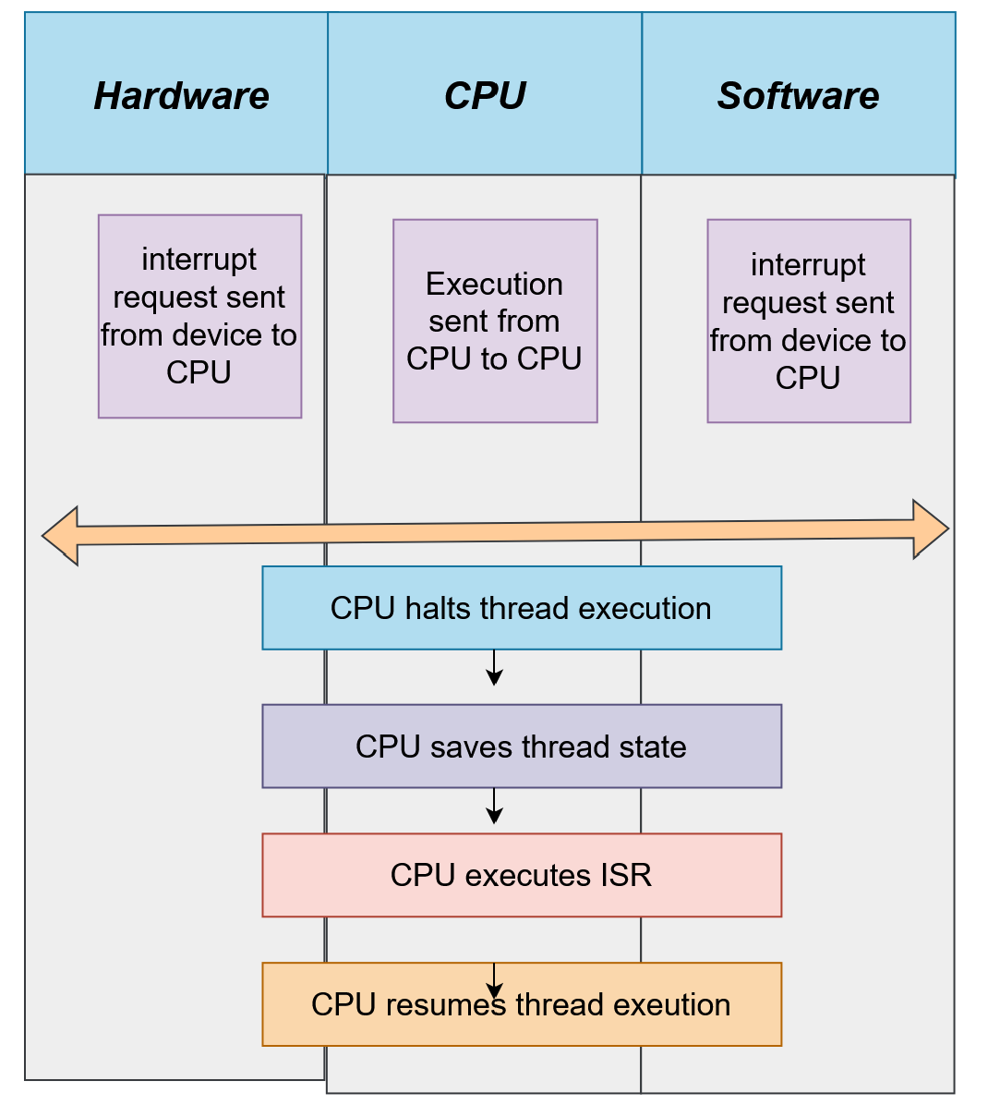
Types of interrupt handler (ISR)
Device-specific interrupt handlers, handle interrupts generated by devices like keyboards, mice, disk drives, and USB devices and interact with the corresponding hardware to perform actions such as reading or writing data.
Timer interrupt handlers are responsible for handling interrupts triggered by hardware timers or system clocks. They manage time-related events and perform tasks such as task scheduling and preemptive multitasking.
Exception handlers with exceptional conditions or events that occur during program execution, such as divide-by-zero errors, page faults, or invalid memory accesses.
Software interrupt handlers are triggered by software-generated interrupts, which are typically initiated through software instructions or system calls

